Slide 1


REPUBLIC OF CAMEROON Peace-Work-Fatherland
REPULIQUE DU CAMEROUN Paix-Travail-Patrie
AFRICAN INSTITUTE OCOMPUTER SCIENCE - CAMEROON OFFICE
REALIZE- YAOUNDE VALLEE AMADOU
DESIGN AND IMPLEMENTATION OF A FOOD, COMMAND DELIVERY PLATFORM
Internship carried out from 3rd July to 30th September 2024
In view of obtaining a HIGHER TECHNITIAN DIPLOMA in Computer Sciences Option: Software Engineering
Written by:
BONG SHALOM NGWI
Level II Student at AICS Cameroon
Academic Supervisor:
Mr. NGUH Prince
Lecturer at AICS-Cameroon
Professional Supervisor:
Mr. NGUH Prince
Software Engineer at REALIZE
ACADEMIC YEAR 2023-2024

Slide 2
PLAN
D
A
C
B
E
UML Diagrams
Demo
Introduction
2TUP
Conclusion

Slide 3
PLAN
A
B
C
D
E
Introduction
Internship site
Context
Problematic
Solution
Methodology
Demo
Conclusion

Slide 4
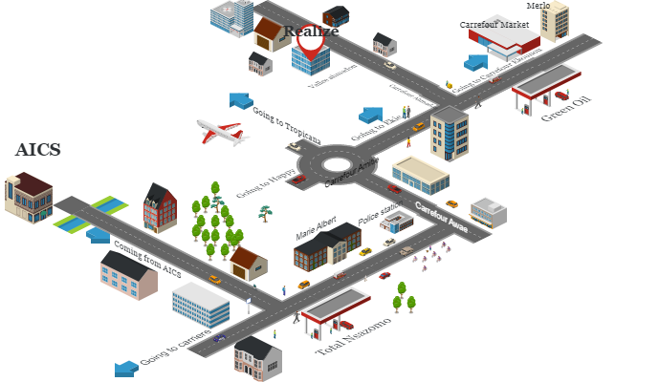
INTRODUCTION
YAOUNDE IV
At EKIE, Valley Amadou
GEOLOCATION
MISSION
KEY REALIZATIONS
To Drive Digital Transformation by producing Innovative and User-Friendly Software, for divers sectors
OneLink
Thekafe

Slide 5




Few customers😔
CONTEXT AND PROBLEMATIC
Can’t leave home😢
Tired😑
hungry🙄
Nadesh
Decay😕😒
James

Slide 6




85%
AVERAGE PEOPLE REQUESTING HOME DELIVERY
25%
2024
2014

Slide 7


PROBLEMATIC
How Do We Connect Businesses With Limited Customers To Customers Willing To Buy

Slide 8





SOLUTION
EASY-EATS

Slide 9

METHODOLOGY
Functional branch
Technical branch
Capture functional needs
Capture technical needs
Analysis
Generic design
Prototype
Preliminary design
Detailed design
Coding and test
Recipe
Realization branch

Slide 10
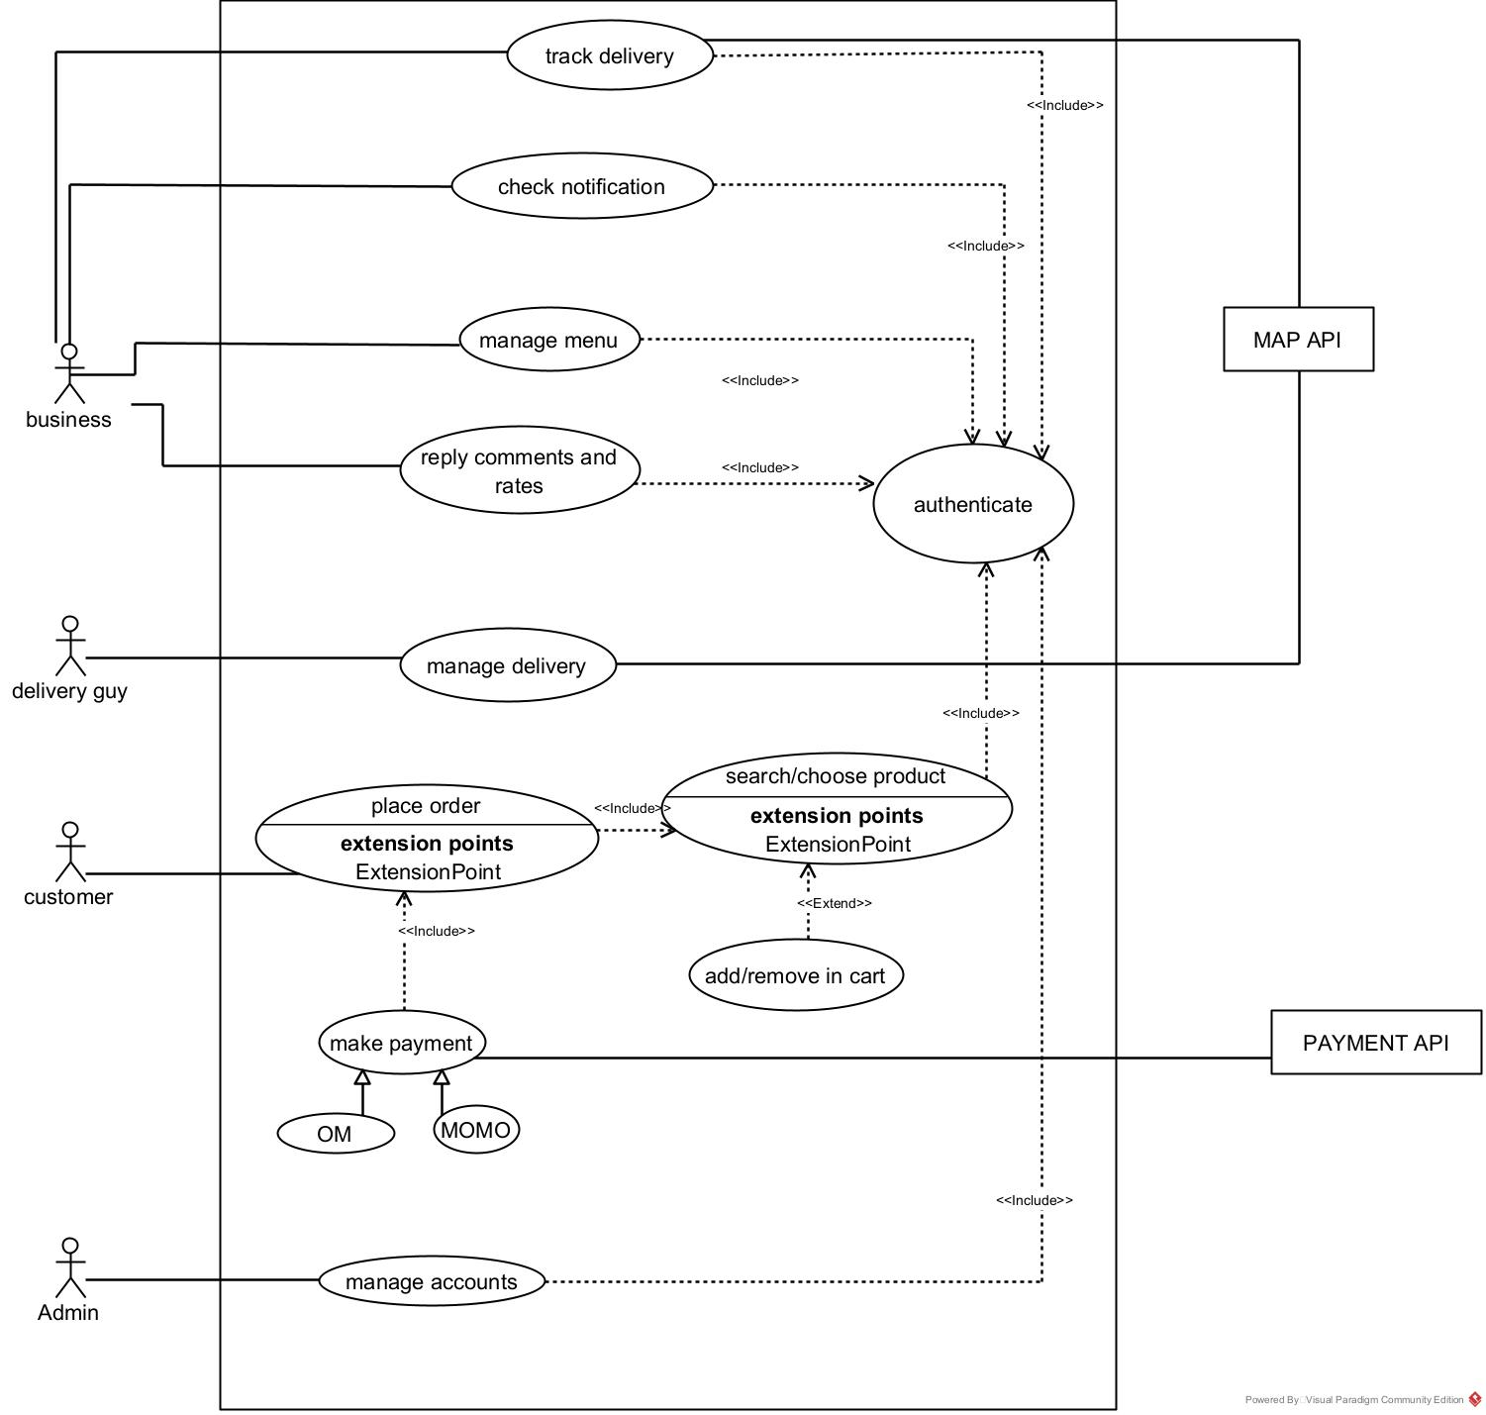
EASY-EATS USE CASE DIAGRAM

Slide 11
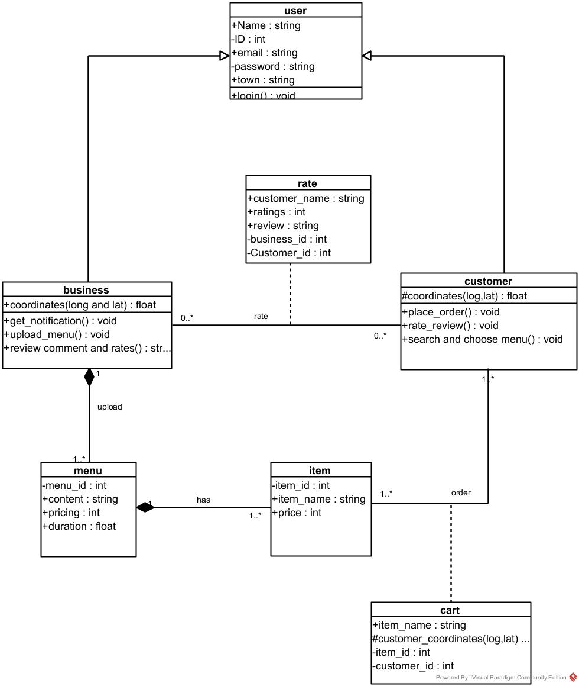
EASY-EATS CLASS DIAGRAM

Slide 12
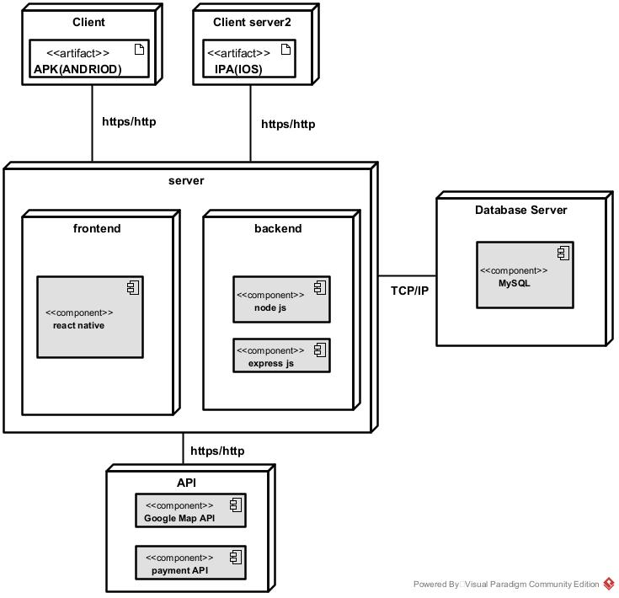
EASY-EATS DEPLOYMENT DIAGRAM

Slide 13
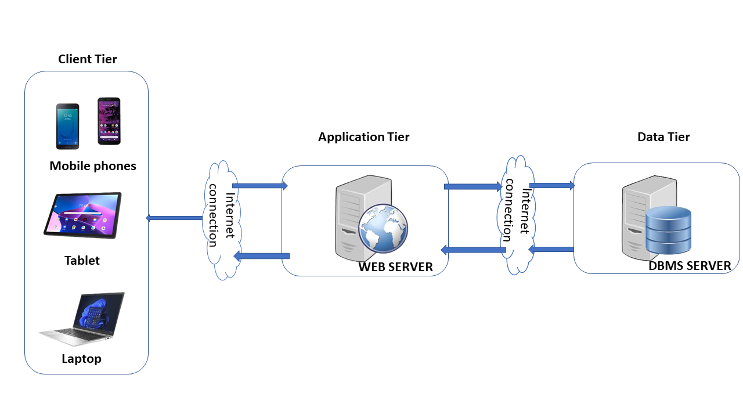
Physical Architecture

Slide 14
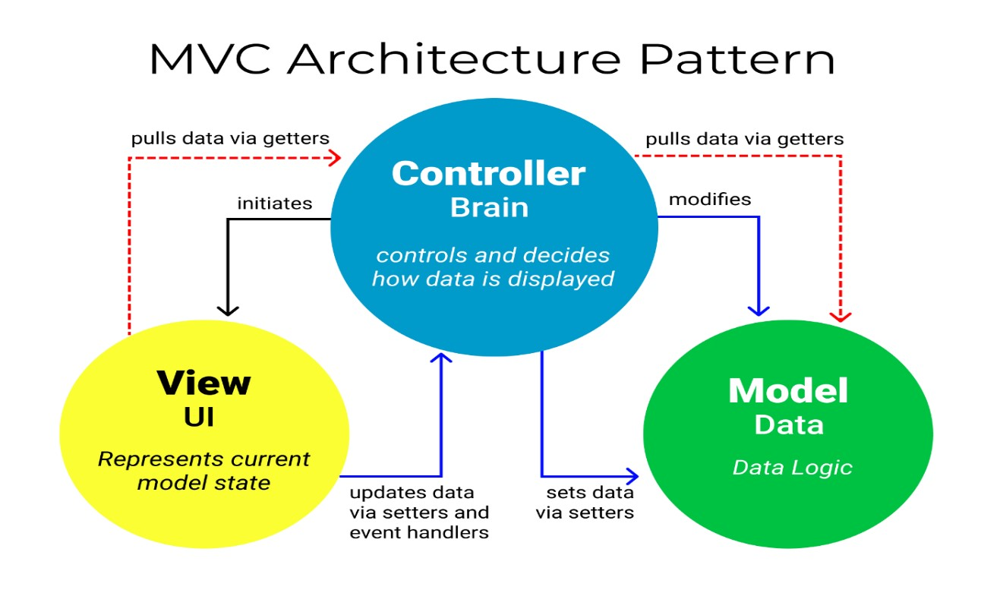
Logical Architecture

Slide 15









TOOLS
FRONT-END
OTHERS
BACKED-END

Slide 16
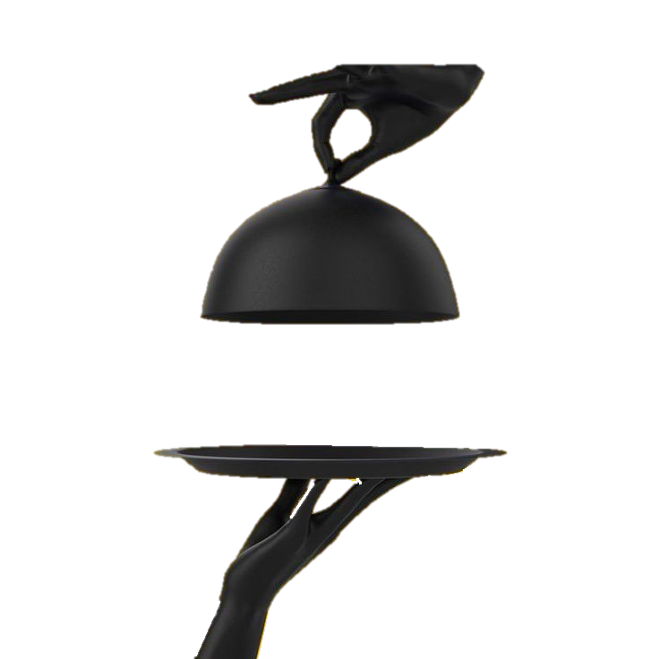
DEMONSTRATION
EASY-EATS DEMONSTRATION

Slide 17


CONCLUSION
Perspectives
Good Business Strategy in relation to businesses.
Neuroscientist: ~Karl Friston~
“when the human brain achieves certainty, it is most at rest”.

Slide 18
